Slide 1
AVL-Tree
Notes:
‹#›

Slide 2
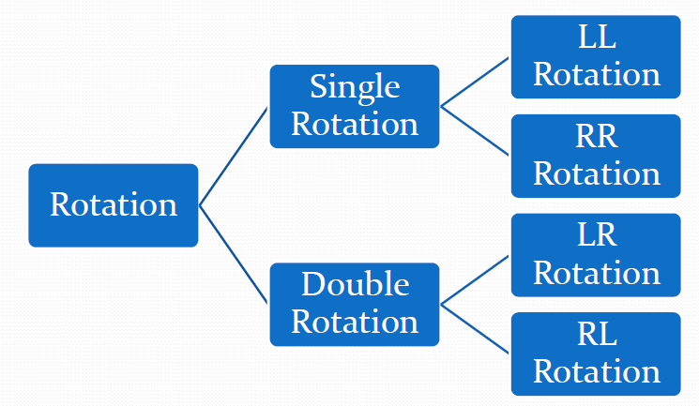
Types of Rotation
Rotation- To switch children and parents among two or
three adjacent nodes to restore balance of a tree.

Slide 3
Types of Rotation
Single Rotation is applied when imbalanced node and
child has same sign of BF (in the direction of new
inserted node).
LL Rotation is applied in case of +ve sign. It mean left
tree is heavy and so LL rotation is done.
RR Rotation is applied in case of -ve sign. It mean right tree is heavy and so RR rotation is done.
Double Rotation is applied when imbalanced node and child has different signs of BF (in the direction of new inserted node).

Slide 4
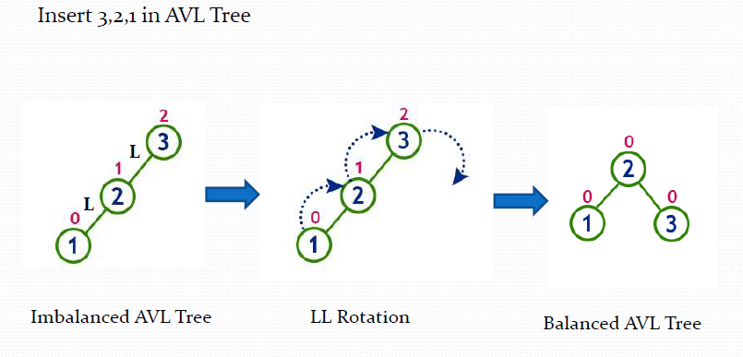
LL Rotation

Slide 5
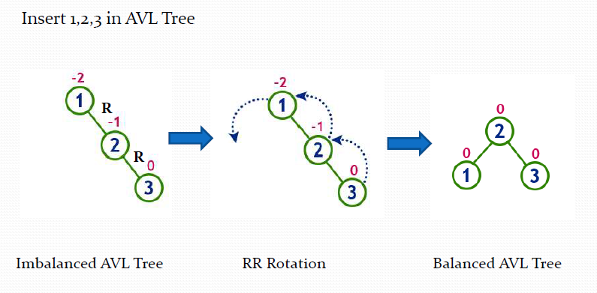
RR Rotation

Slide 6
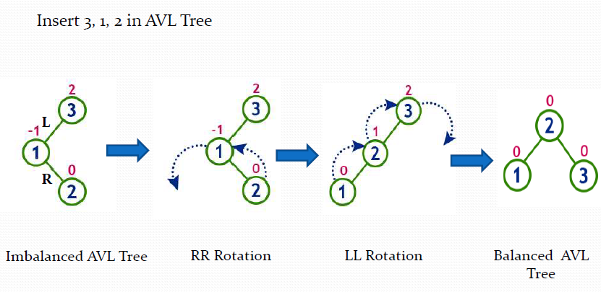
LR Rotation

Slide 7
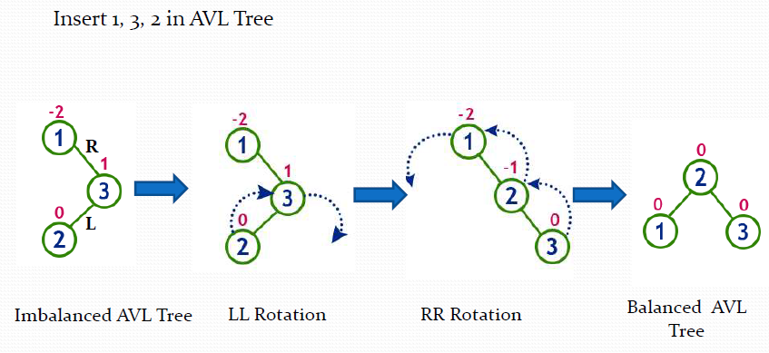
RL Rotation

Slide 8
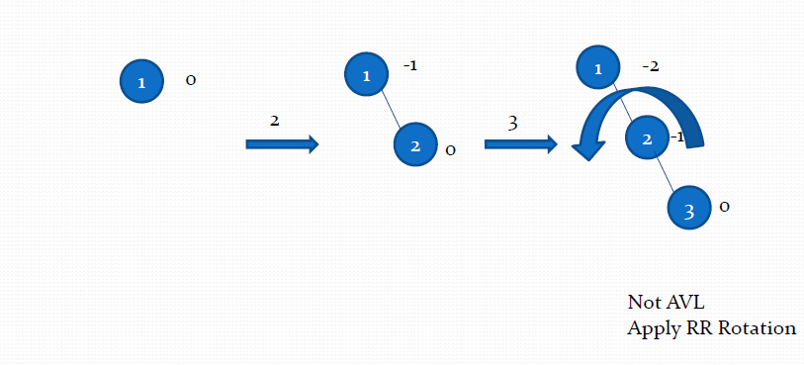
Construct a AVL Tree by inserting
from 1 to 5 numbers

Slide 9
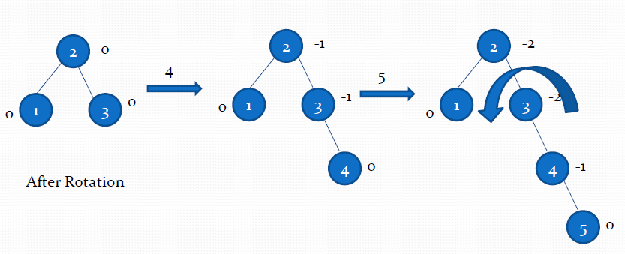
Construct a AVL Tree by inserting
from 1 to 5 numbers

Slide 10
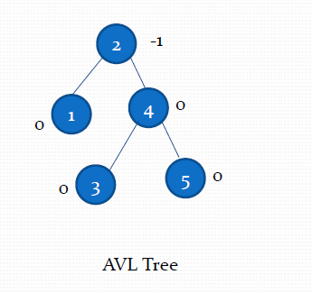
Construct a AVL Tree by inserting
from 1 to 5 numbers

Slide 11
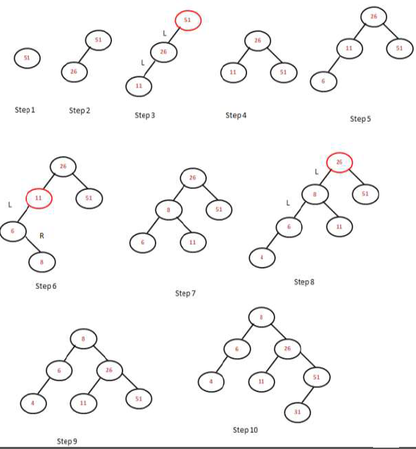
Construct AVL Tree with data items: 51, 26, 11, 6, 8, 4, 31

Slide 12
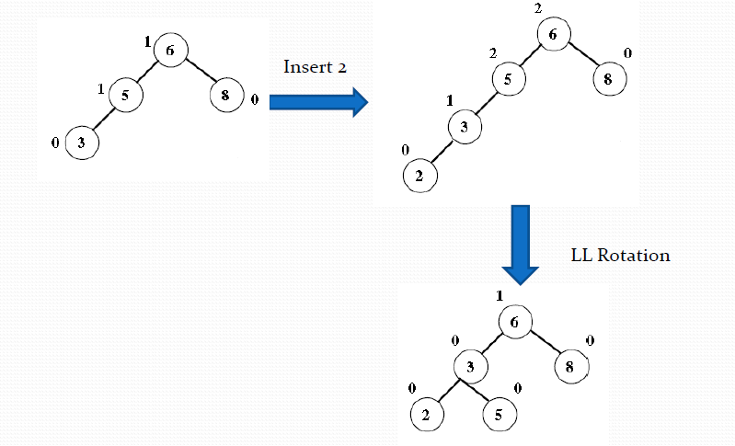
Insertion in AVL Tree

Slide 13
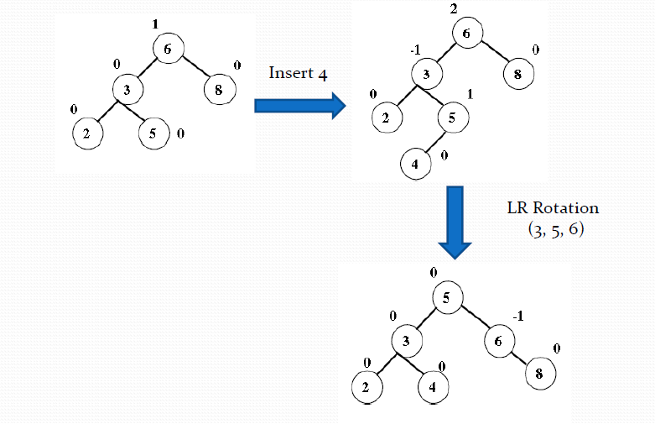
Insertion in AVL Tree

Slide 14
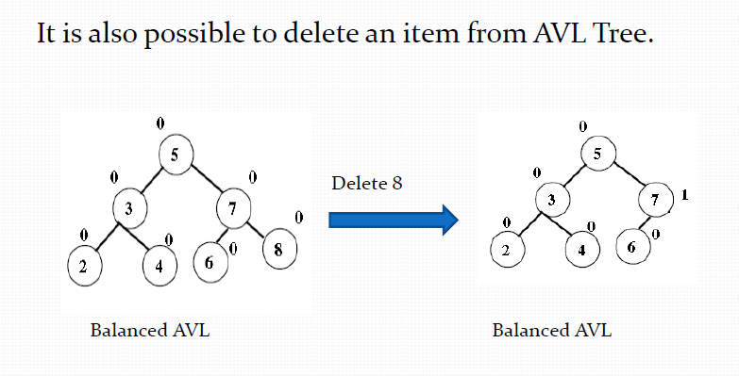
Deletion in AVL Tree

Slide 15
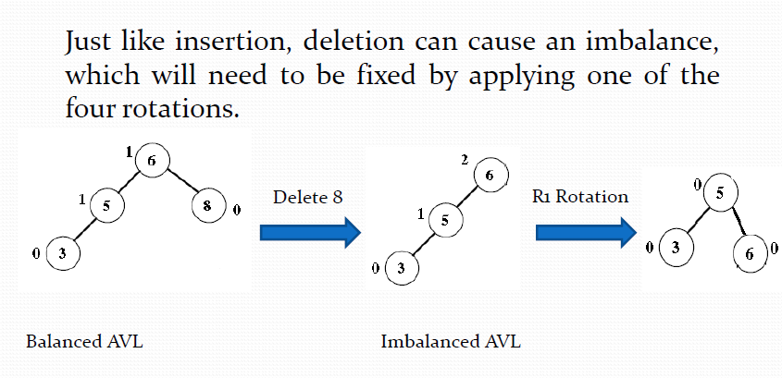
Deletion in AVL Tree

Slide 16
Deletion in AVL Tree
The deletion is also the same as in BST. However, in
imbalanced tree due to deletion, one or more rotations need to be applied to balance the AVL tree.
The Right(R) imbalance is classified into R0, R1, R-1
The Left(L) imbalance is classified into L0, L1, L-1

Slide 17
Deletion in AVL Tree
LL Rotation is same to R0 and R1
RR Rotation is same to L0 and L-1
LR Rotation is same to R-1
RL Rotation is same to L1

Slide 18
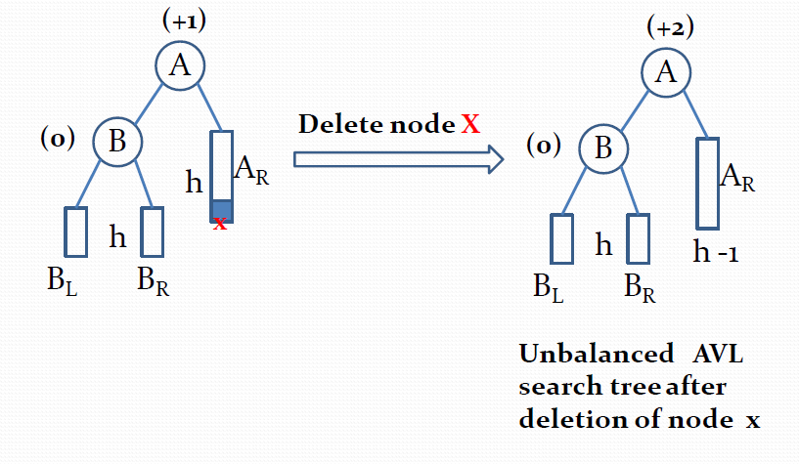
R0 Rotation

Slide 19
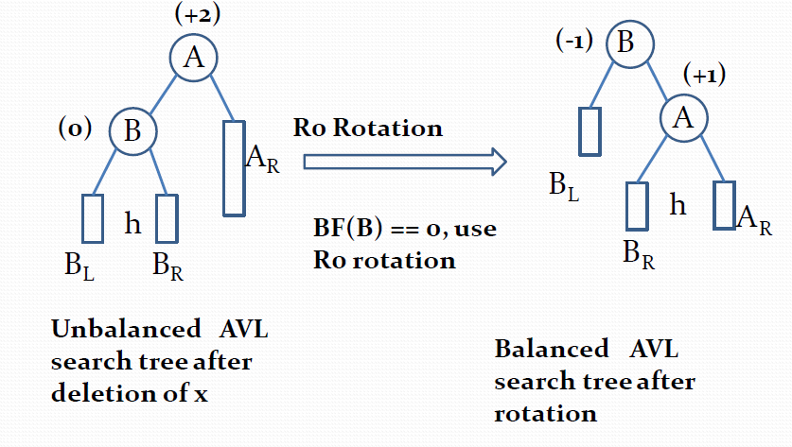
R0 Rotation

Slide 20
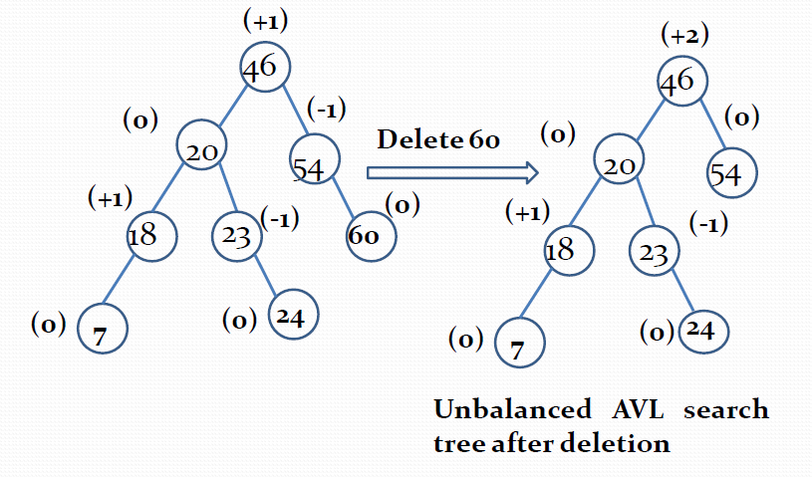
R0 Rotation Example

Slide 21
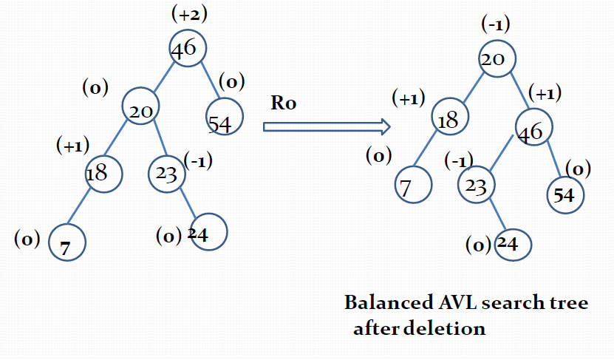
R0 Rotation Example

Slide 22
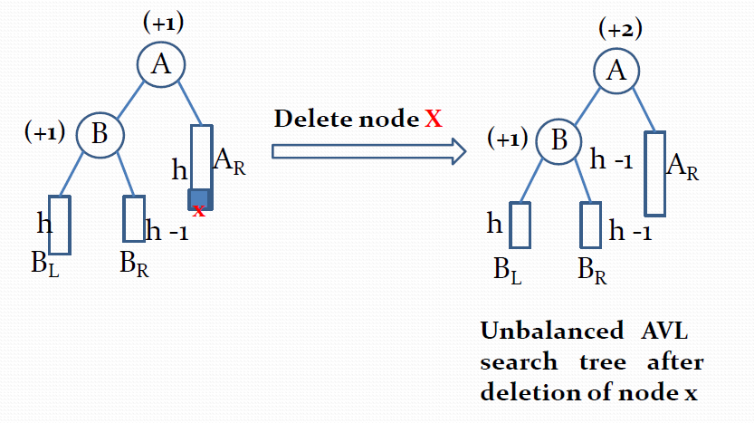
R1 Rotation

Slide 23
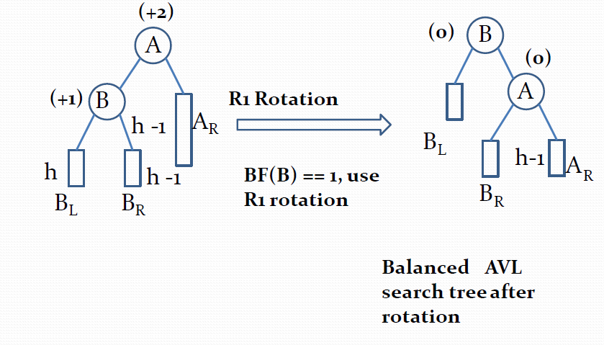
R1 Rotation

Slide 24
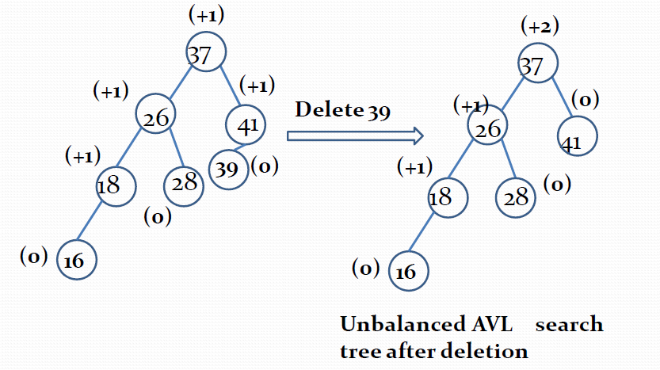
R1 Rotation Example

Slide 25
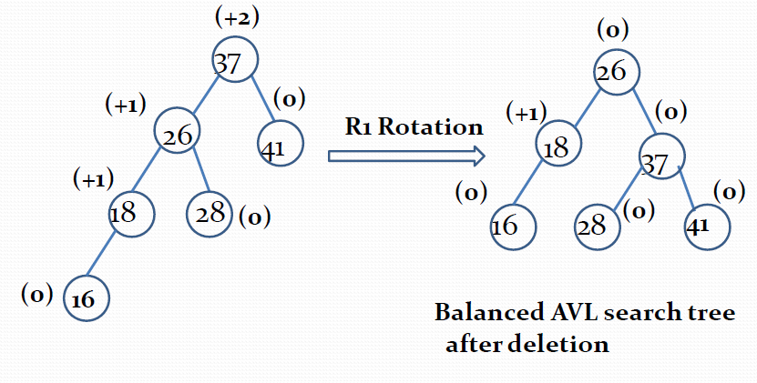
R1 Rotation Example

Slide 26
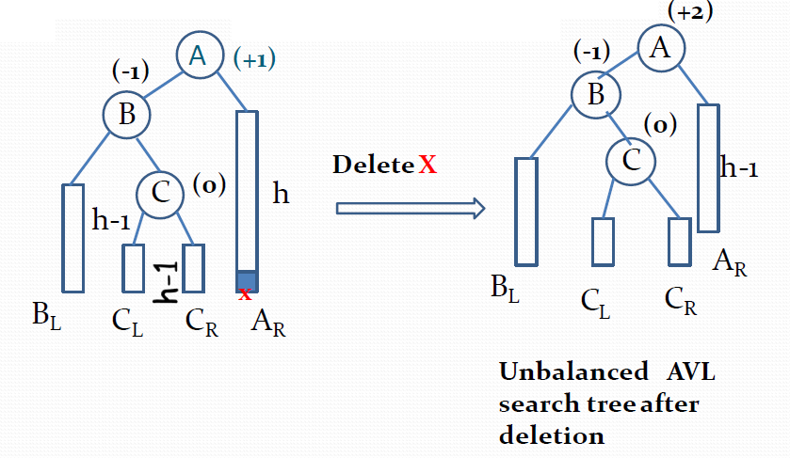
R-1 Rotation

Slide 27
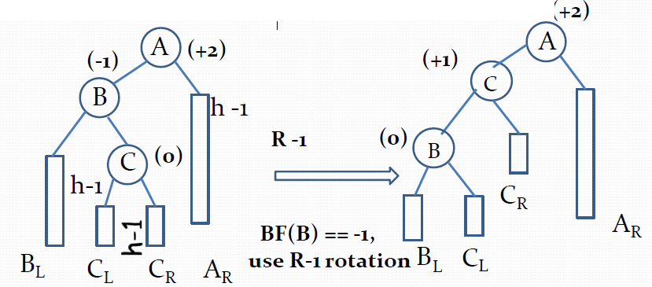
R-1 Rotation

Slide 28
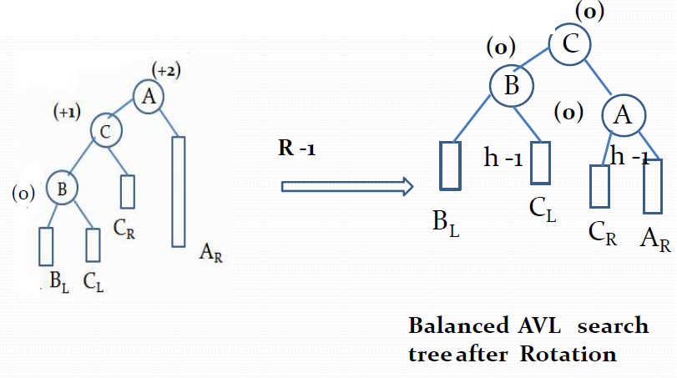
R-1 Rotation

Slide 29
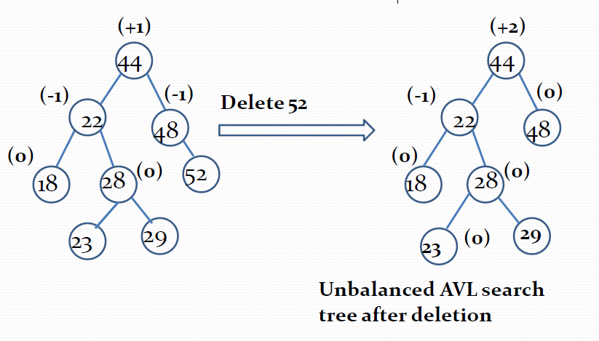
R-1 Rotation Example

Slide 30
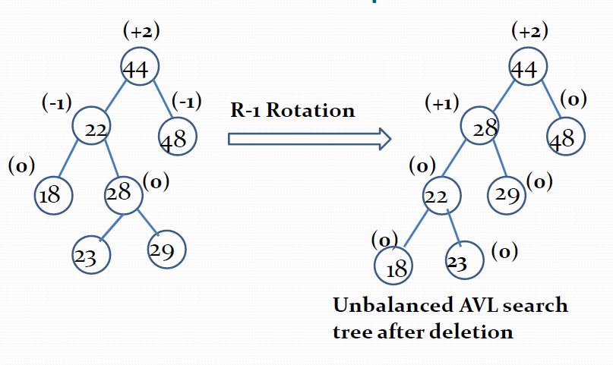
R-1 Rotation Example

Slide 31
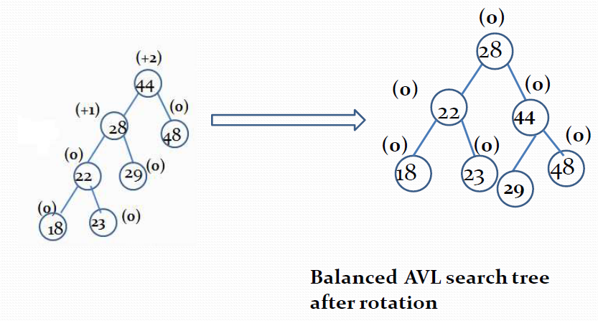
R-1 Rotation Example

Slide 32
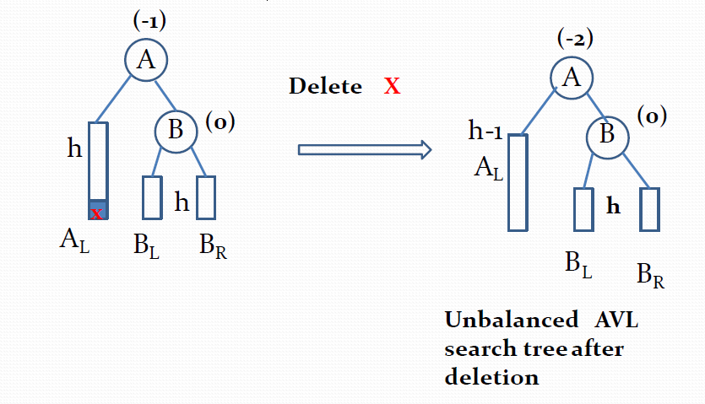
L0 Rotation

Slide 33
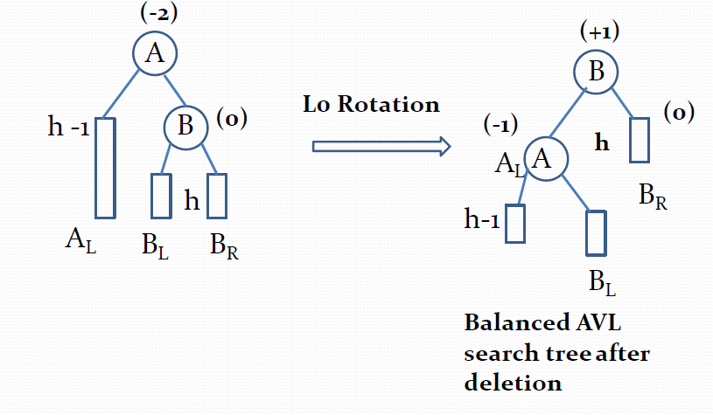
L0 Rotation

Slide 34
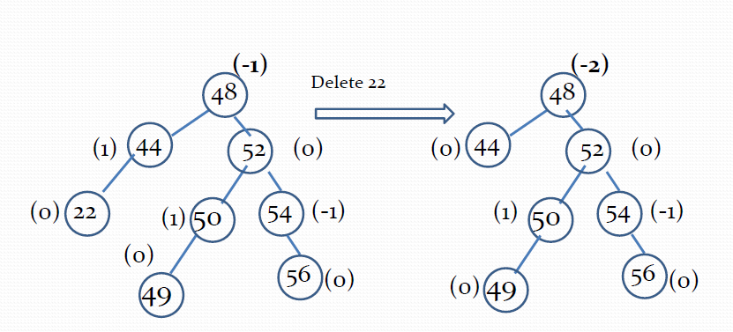
L0 Rotation

Slide 35
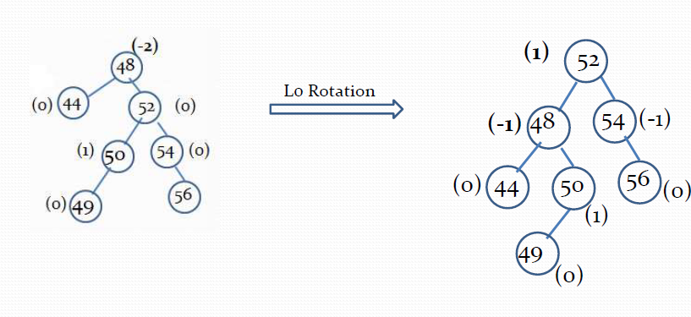
L0 Rotation

Slide 36
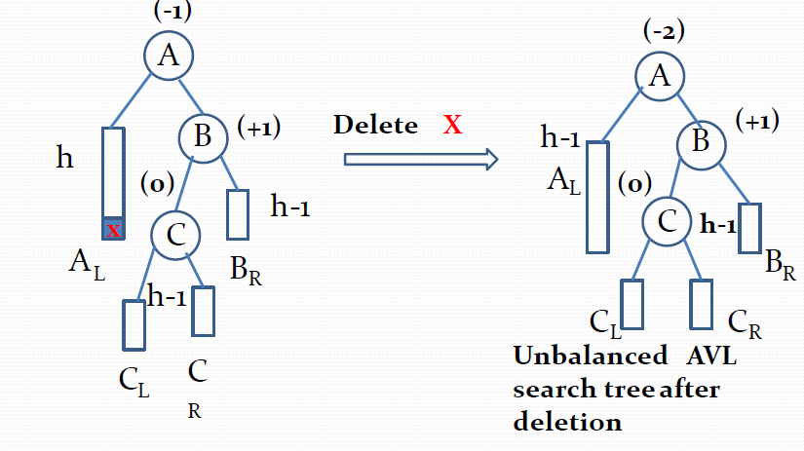
L1 Rotation

Slide 37
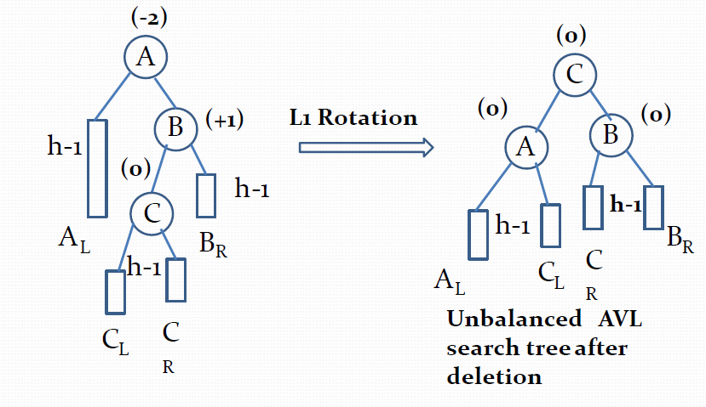
L1 Rotation

Slide 38
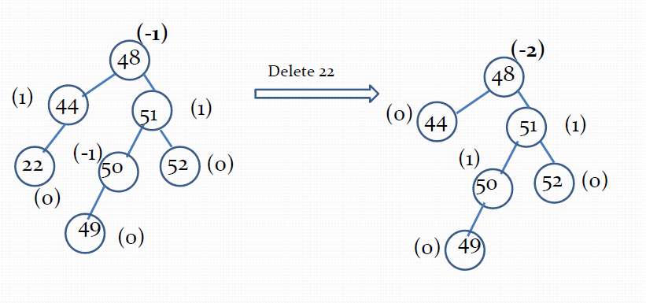
L1 Rotation

Slide 39
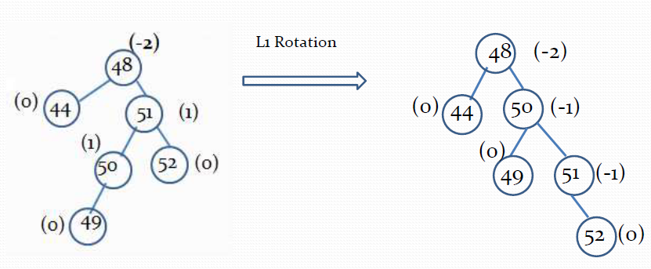
L1 Rotation

Slide 40
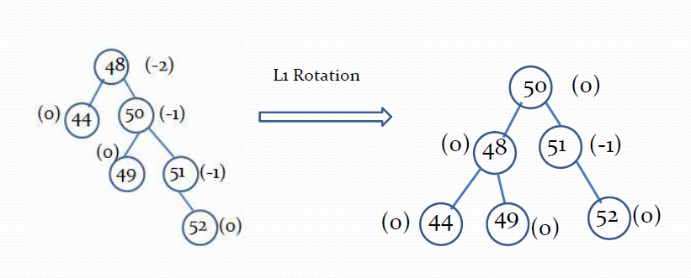
L1 Rotation

Slide 41
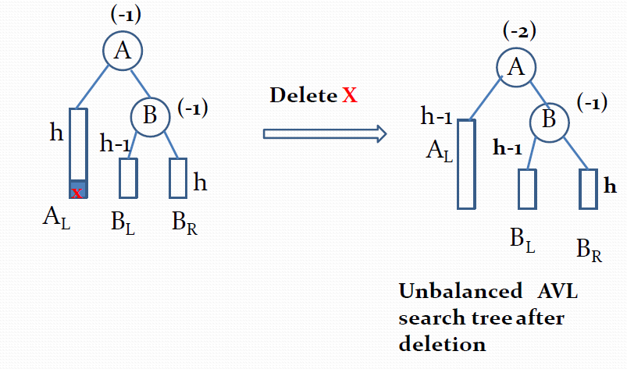
L-1 Rotation

Slide 42
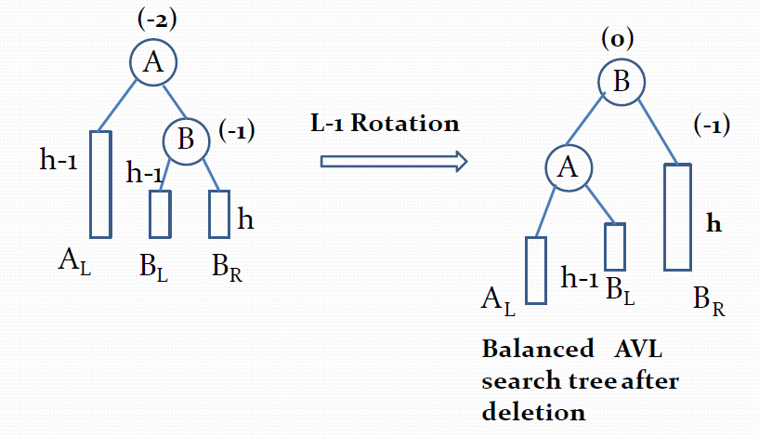
L-1 Rotation

Slide 43
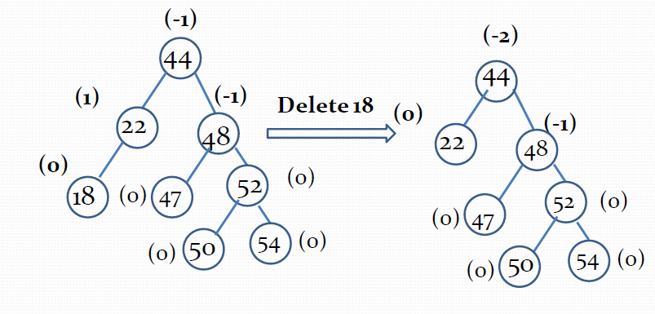
L-1 Rotation

Slide 44
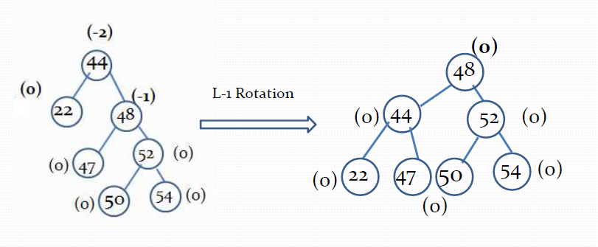
L-1 Rotation

Slide 45
Problem-1
10, 6, 11, 12, 1, 7, 0, 2, 3

Slide 46
Problem-2
B, C, G, E, F, D, A

Slide 47
Problem-3
21, 26, 30, 9, 4, 14, 28, 18, 15, 10, 2, 3, 7

Slide 48
Problem-4
2, 3, 10, 18, 4, 9, 14, 7, 15

